Slide 1
Capstone Project
Bank Marketing Effectiveness Prediction
Shubham Sharma

Slide 2

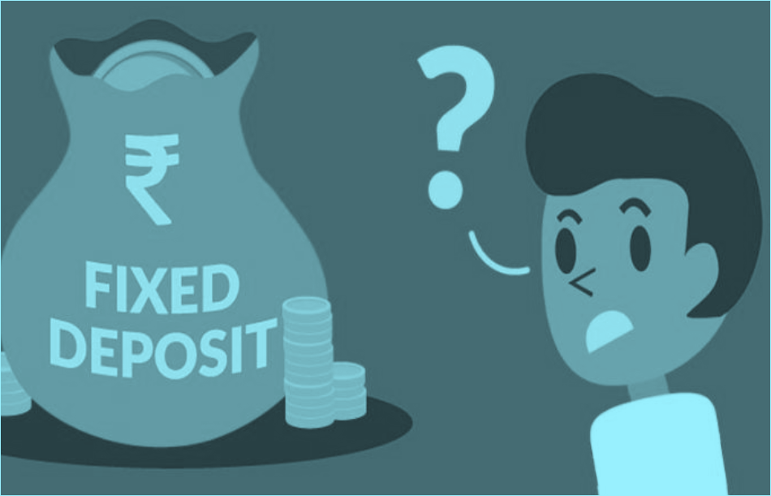
Can Machines Predict Future? Let’s find out!
Project Background
Exploratory Data Analysis
Data Cleaning and Oversampling
Machine Learning: Classification
Stacking
Survival of the Fittest
Declaring the Winner
Feature Importance(SHAP)
Conclusion

Slide 3

What to achieve?
Main Objective: Increase the effectiveness of the bank's telemarketing campaign.
Problem Statement: The data is related with direct marketing campaigns of a Portuguese banking institution. The marketing campaigns were based on phone calls. Often, more than one contact to the same client was required, in order to access if the product (bank term deposit) would be ('yes') or not ('no') subscribed.The classification goal is to predict if the client will subscribe a term deposit (variable ‘y’).

Slide 4
Data Menu
Categorical Features
Marital - (Married , Single , Divorced)
Job-(Management,BlueCollar,retired etc)
Contact - (Telephone,Cellular,Unknown)
Education (Primary,Secondary,Tertiary)
Month-(Jan,Feb,Mar,Apr,May etc)
Poutcome - (Success,Failure,Other,Unknown)
Housing - (Yes/No)
Loan - (Yes/No)
Default - (Yes/No)
Numerical Features
Age
Balance
Day
Duration
Campaign
Pdays
Previous

Slide 5
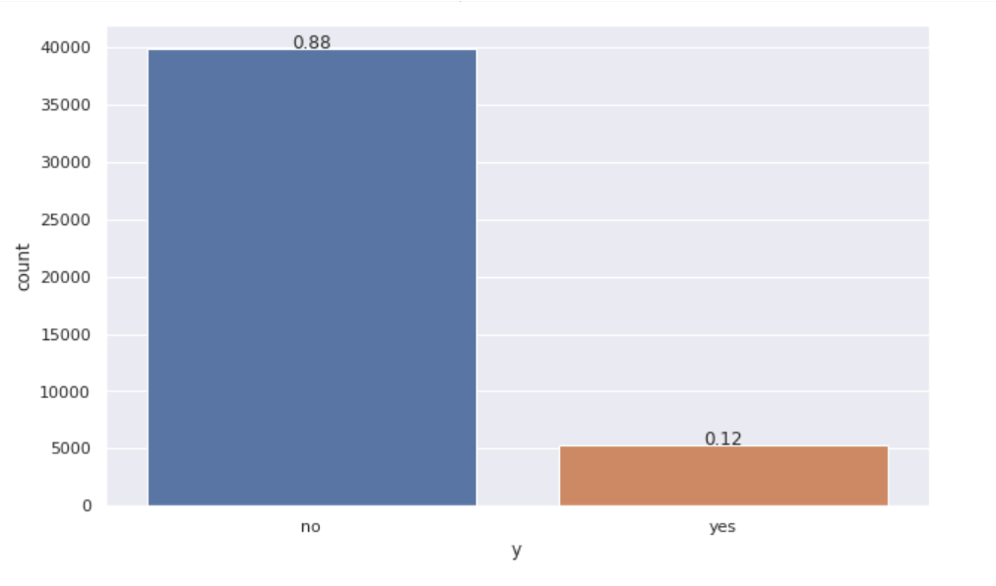
Defining the Target
The target variable tells us the outcome of the campaign whether they went ahead for the term deposit or not.
Looking at the plot below we can say that the percentage of people subscribing for term is deposit is quite low, thus creating an imbalance in the data.

Slide 6
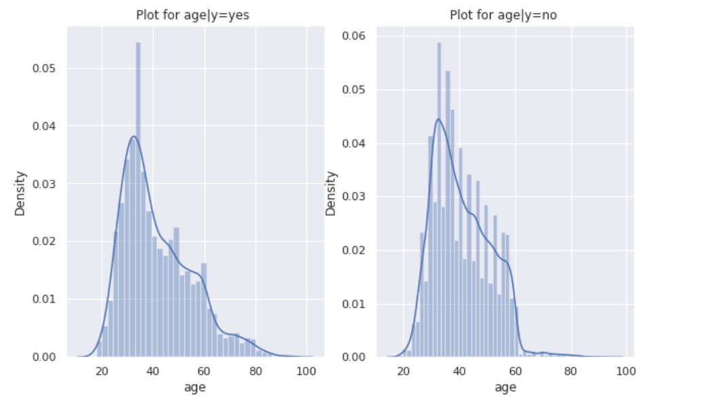
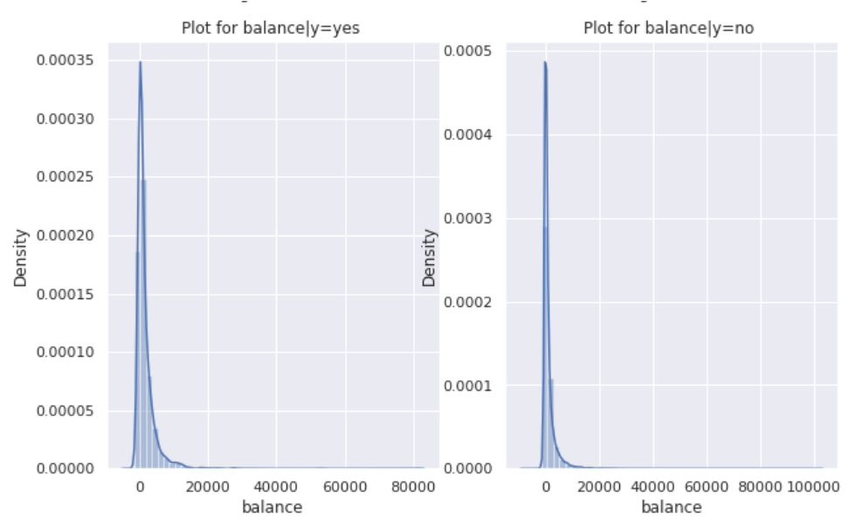
EDA
The distribution account balance of people deciding to say ‘yes’ or ‘no’ for term deposit.
The distribution age of people deciding to say ‘yes’ or ‘no’ for term deposit.

Slide 7
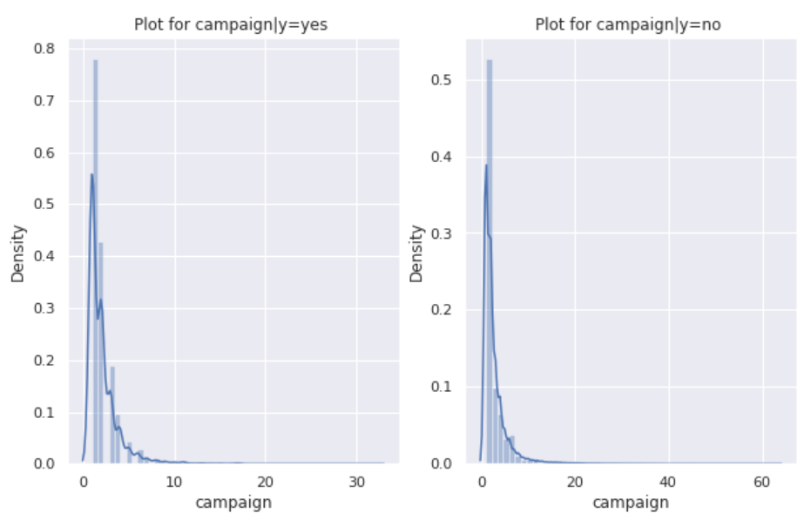
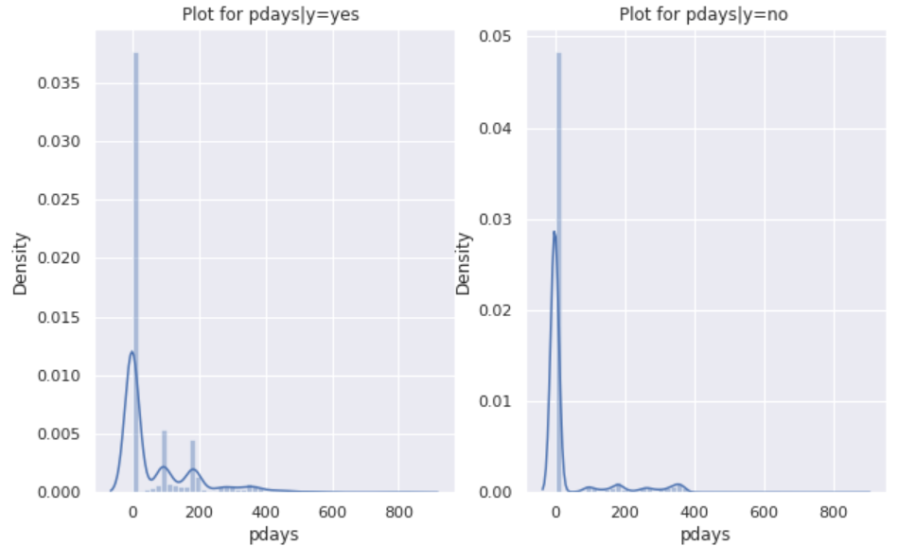
EDA(continued)

Slide 8
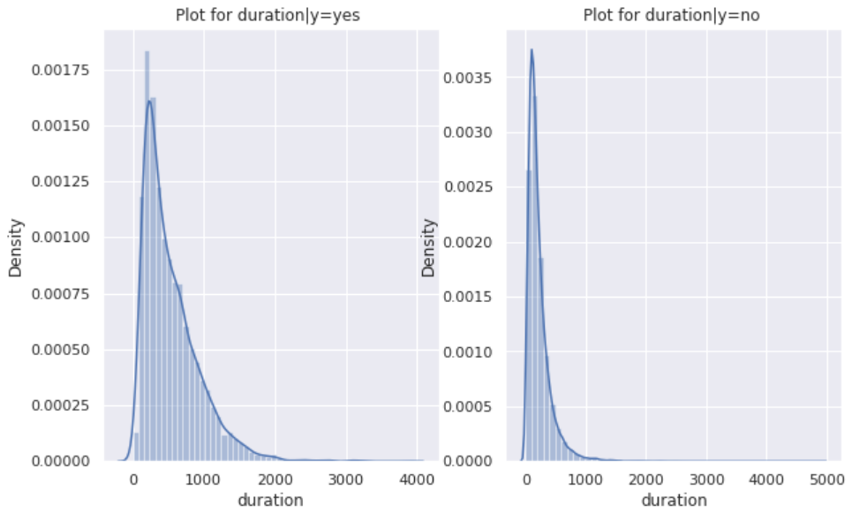
EDA(continued)
This features on first glance looks of great relevance for the model, but it needs to be dropped as it is futuristic.
It has nothing to do with prediction of successful subscriptions.

Slide 9
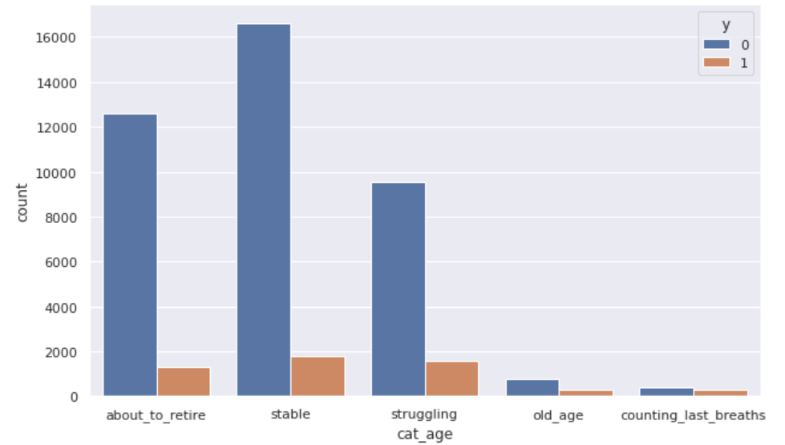
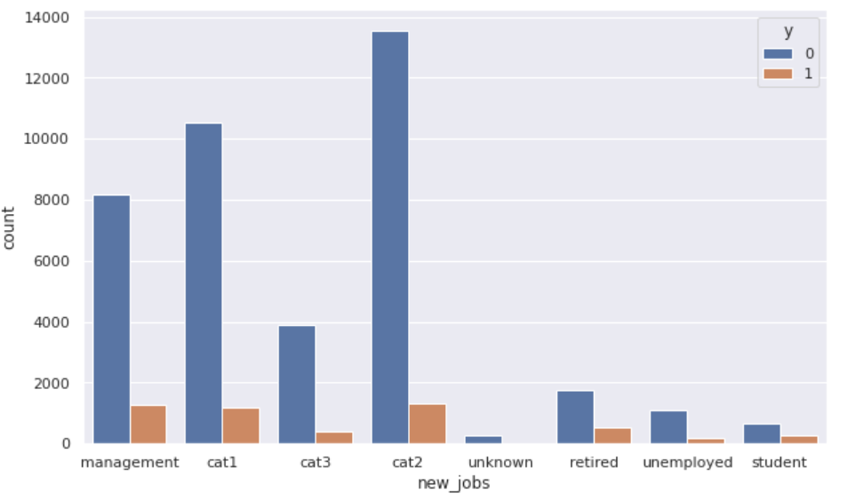
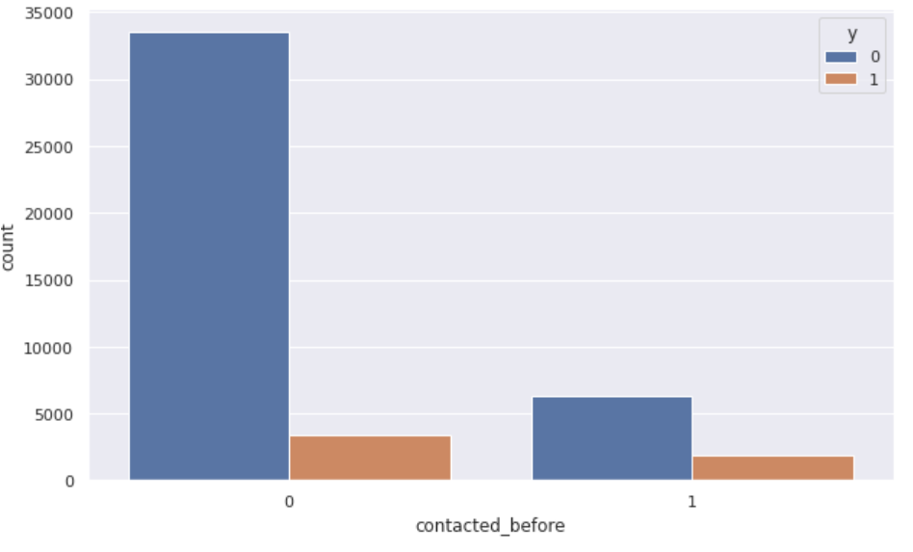
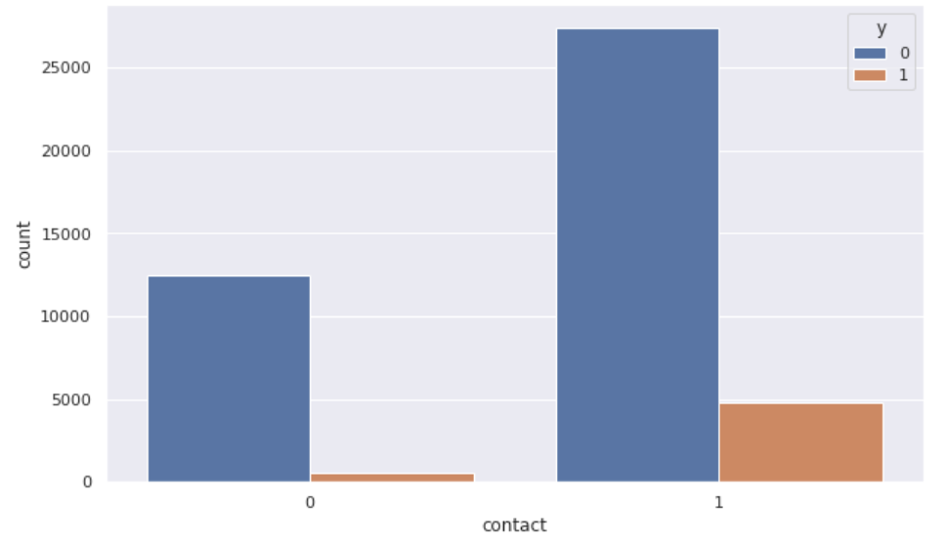
Feature Engineering

Slide 10
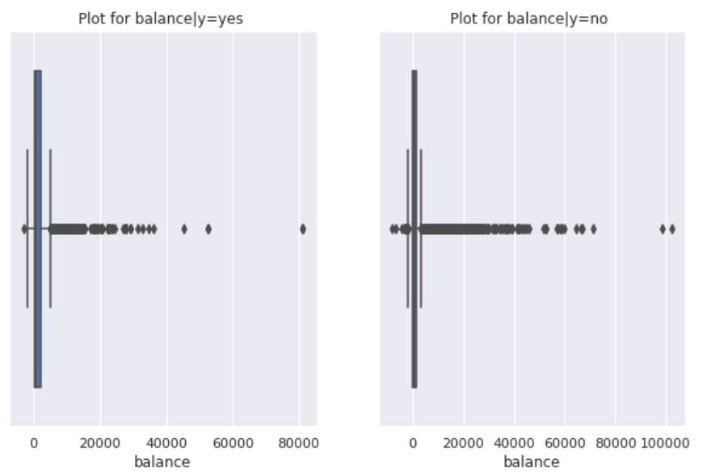
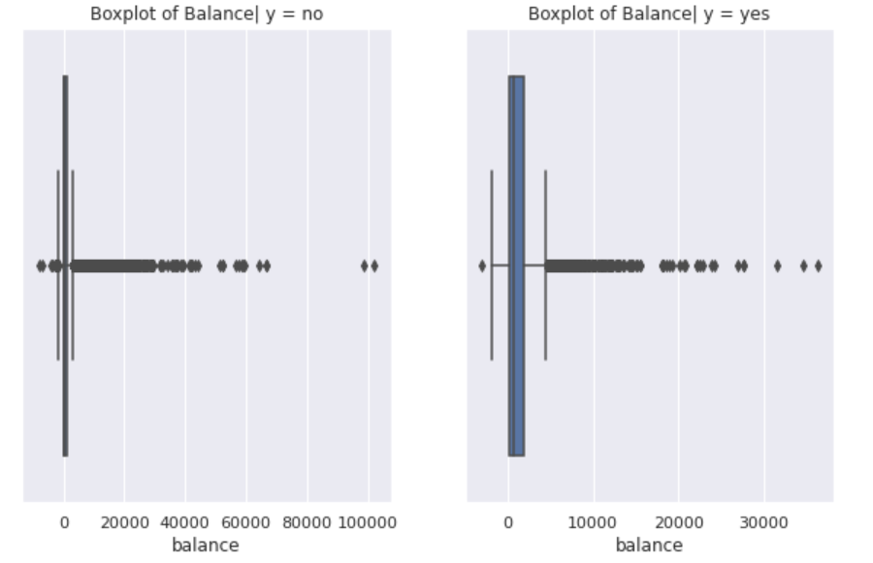
Eliminating Oddity(Isolation Forest)
Before
After

Slide 11
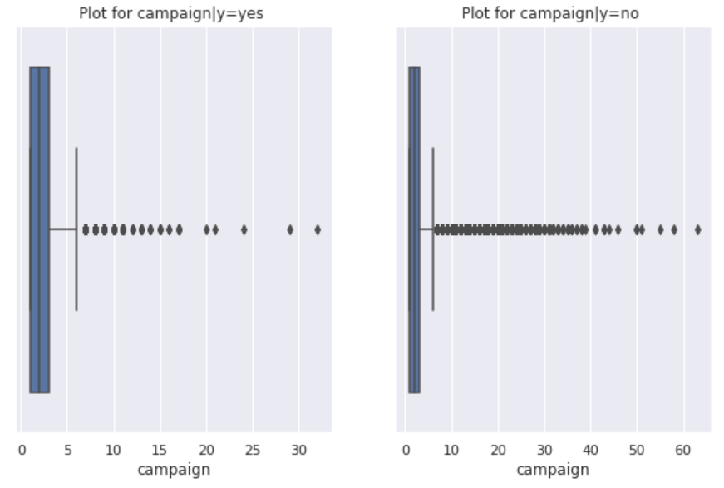
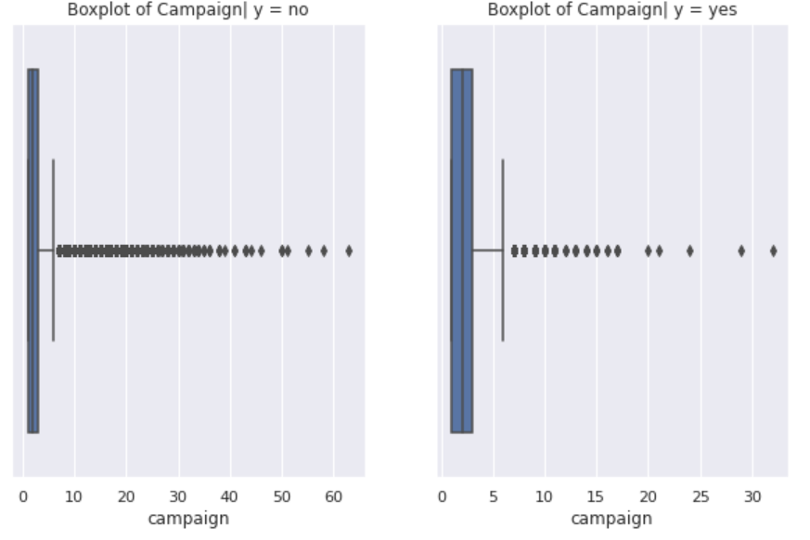
Eliminating Oddity(continued)
Before
After
We scaled the data before using SMOTE

Slide 12
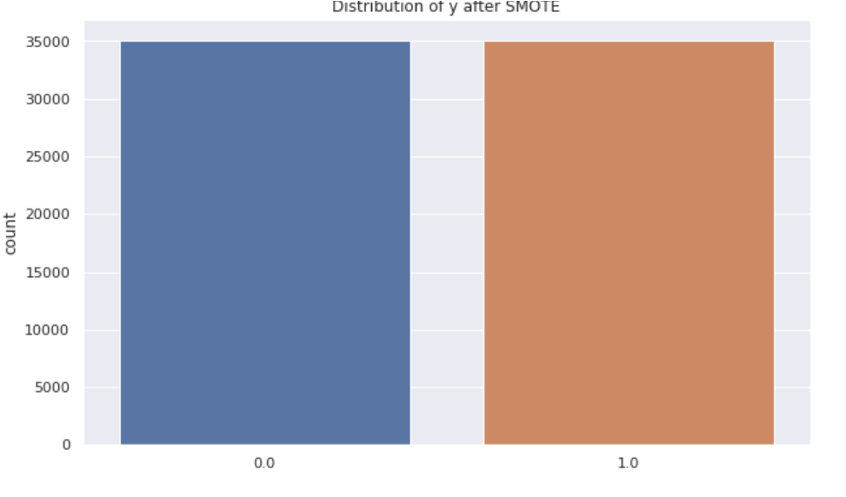
Oversampling(SMOTE)
Before
After

Slide 13
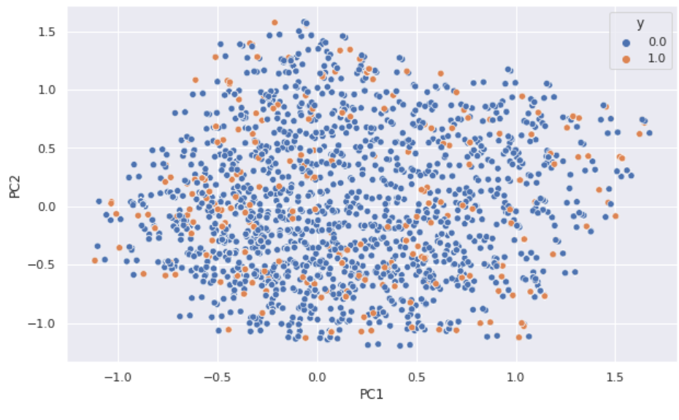
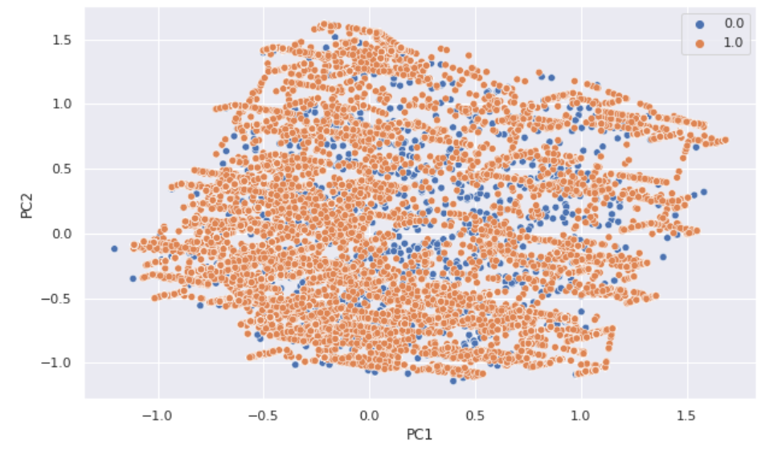
Oversampling(SMOTE) continued..
Before
After

Slide 14
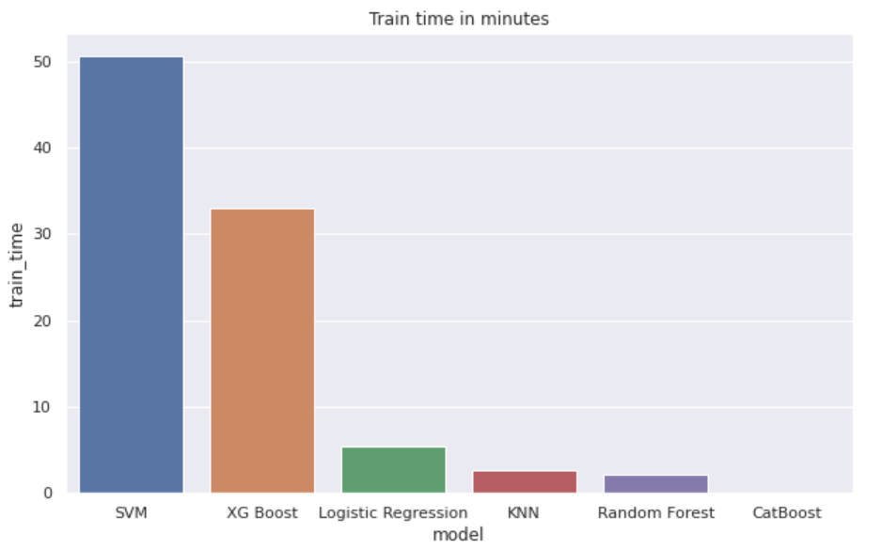
Applying ML Models
I

Slide 15
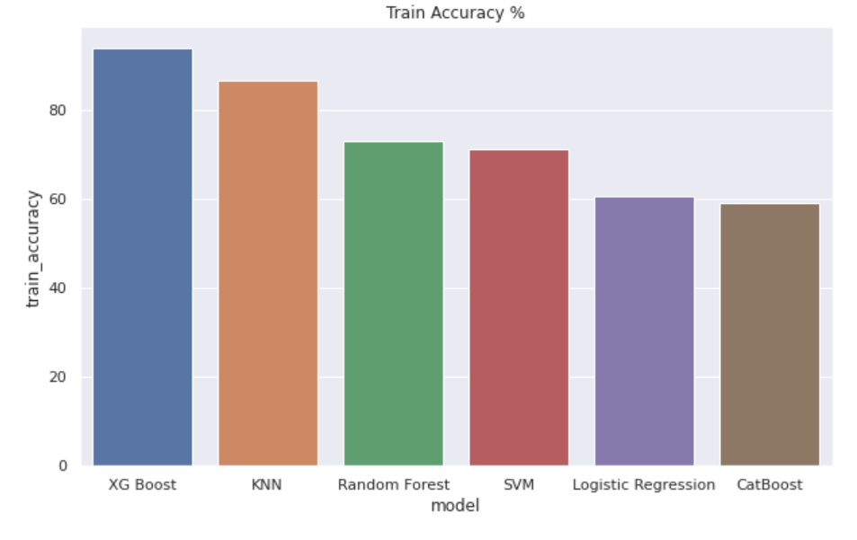
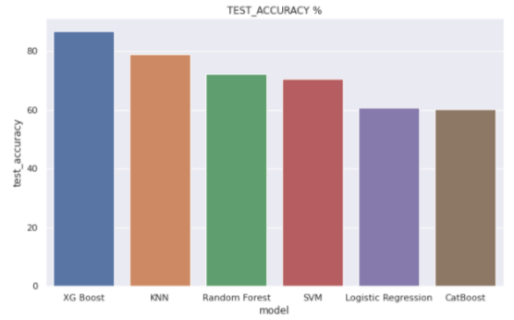
Survival of the Fittest(Accuracy)

Slide 16
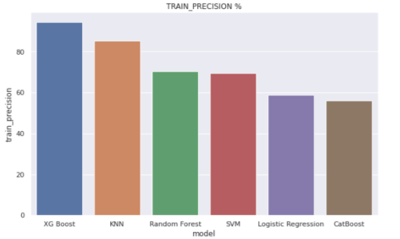
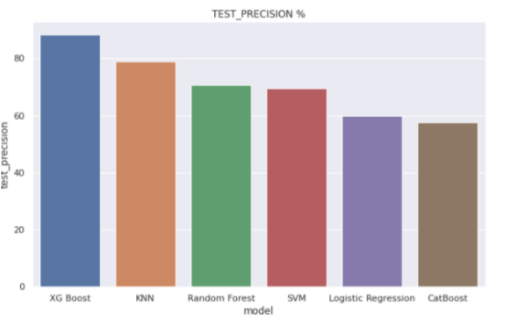
Survival of the Fittest(Precision)

Slide 17
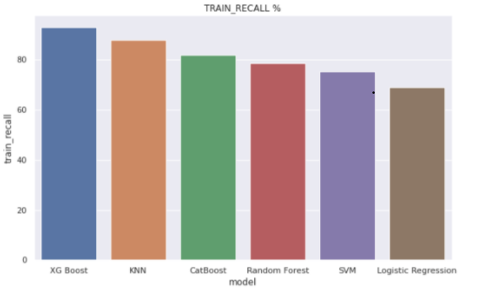
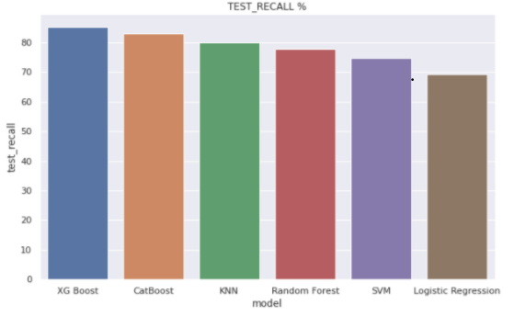
Survival of the Fittest(Recall)

Slide 18
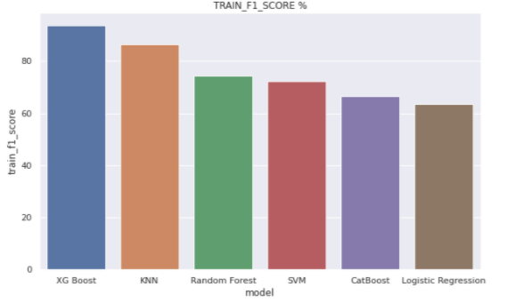
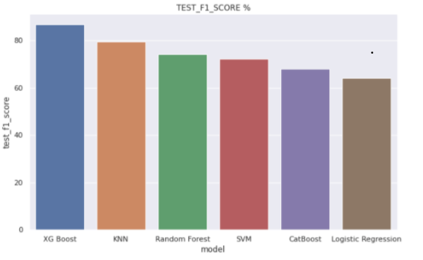
Survival of the Fittest(F1-Score)

Slide 19
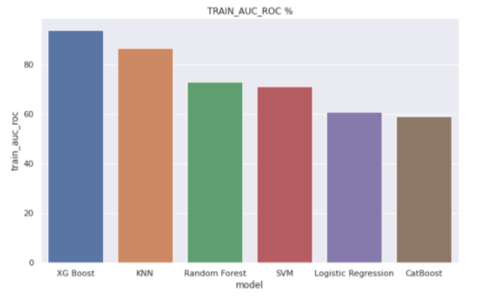
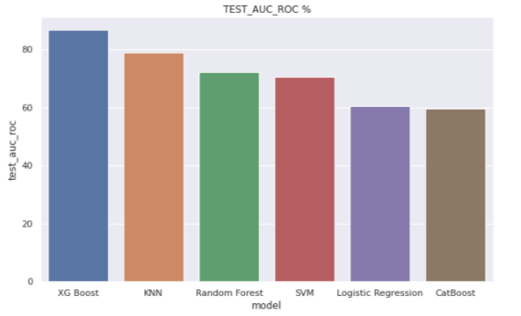
Survival of the Fittest(AUC-ROC)

Slide 20
XGBoost
Parameters for GridSearchCV
{'learning_rate': [0.1,0.3,0.5], 'max_depth': [5,7,10], 'n_estimators': [50,100], 'reg_lambda': [0.1,1,10], 'seed': [123]}
Best Parameters
{'learning_rate': 0.3, 'max_depth': 10, 'n_estimators': 100, 'reg_lambda': 1, 'seed': 123}

Slide 21

Declaring the Winner
As seen from all the metric above , the best metric to measure the goodness of the model is AUC-ROC and Accuracy(as we have a balanced data set after using SMOTE).
Thus,we would declare XG Boost as the winner among all the models having the best accuracy and AUC-ROC, taking a decent amount of time for training as shown above.

Slide 22
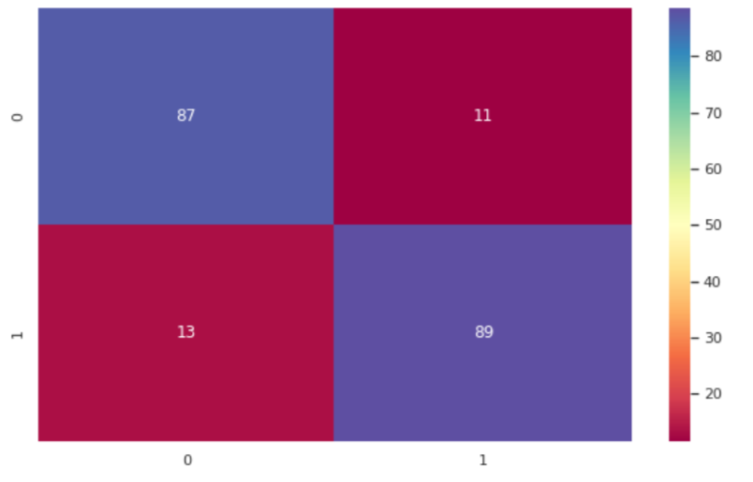
Stacking
Used logistic regression as the meta model.
Stacking Accuracy : 0.8760
Stacking Precision:
0.8854
Stacking Recall :
0.8651
Stacking AUC :
0.8761
6286
791
953
6114

Slide 23
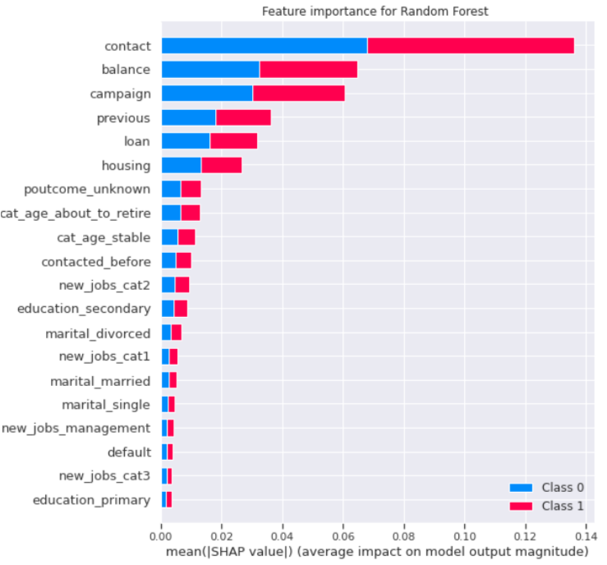
Feature Importance(Using Shapley Value)

Slide 24
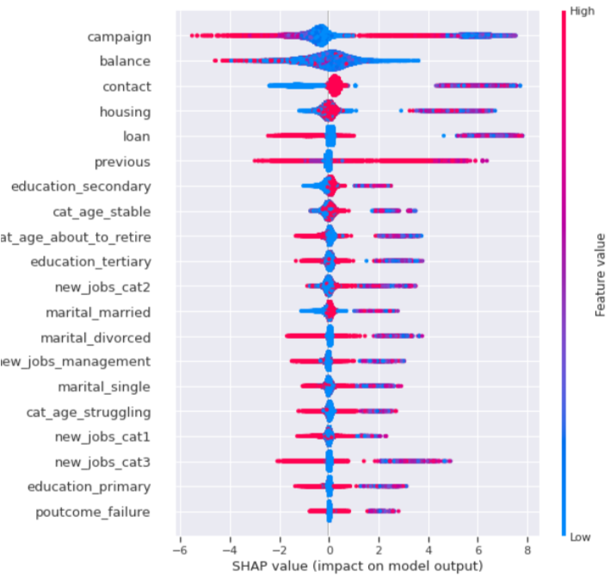
Feature Importance(Using Shapley Value)

Slide 25
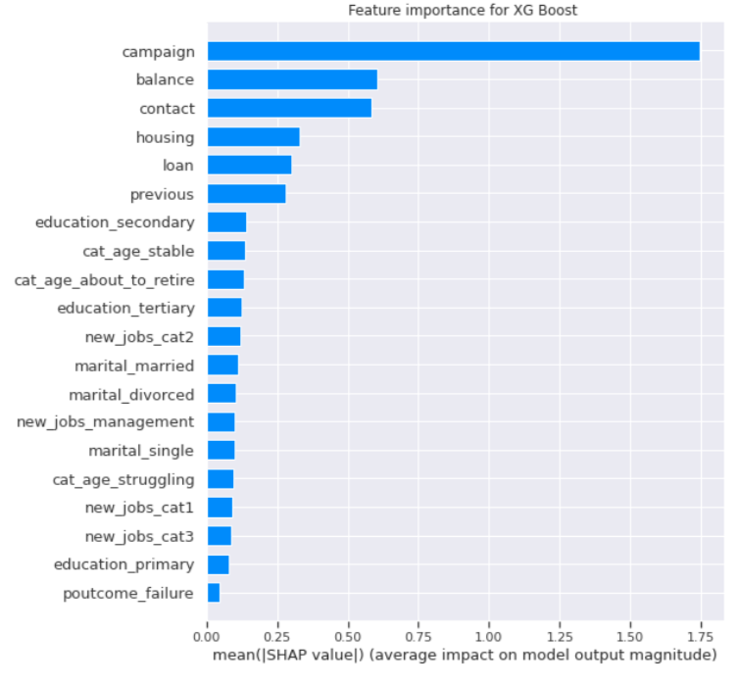
Feature Importance(Using Shapley Value)

Slide 26
Conclusion
XGBoost has shown the best performance, but in the end it was able to identify slightly more that a half of positive outcomes, which tells me there must be ways to improve it.
The customer's account balance has a huge influence on the campaign's outcome. People with account balance above 1490$ are more likely to subscribe for term deposit, so future address those customers.
The customer's age affects campaign outcome as well. Future campaigns should concentrate on customers from age categories below 30 years old and above 50 years old.
Number of contacts with the customer during the campaign is also crucial. The number of contacts with the customer shouldn't exceed 4.

Slide 27
Q & A

